Slide 1




Neurodiversity & Learning Disabilities

Slide 3






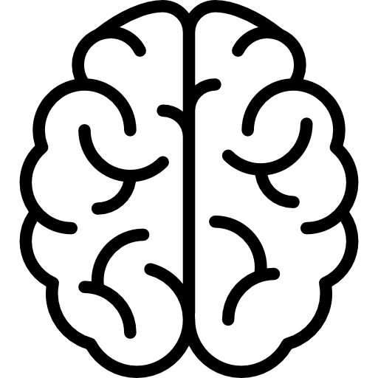











Dyslexia?
What is
Dyslexia is a learning disorder that involves difficulty reading due to problems identifying speech sounds and learning how they relate to letters and words (decoding)
Main Challenges
Matching Letter Symbols to Sound
Matching Sounds to Letter Symbols
De-coding meaning Reading
En-coding meaning Writing and Spelling
I na hrer.
Yo ar fune.
I am here.
You are funny.
1 in 10 people have Dylexia
Areas where Dyslexia DON’T Excel
Areas where Dyslexia DO Excel
Memory
Visual Perception
Auditory Perception
Spoken Language
Reading
Spelling
Art
Computer Science
Music
Drama
Sports
Math

Slide 4
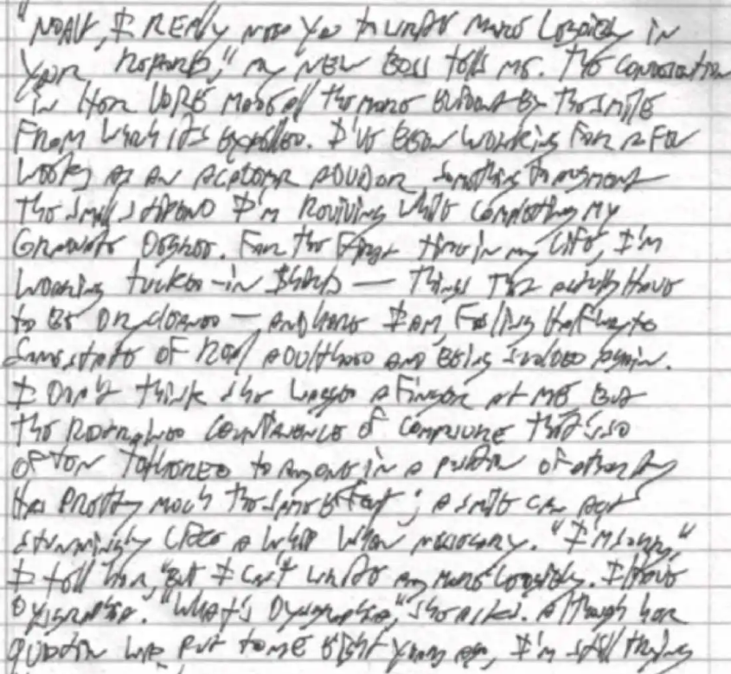
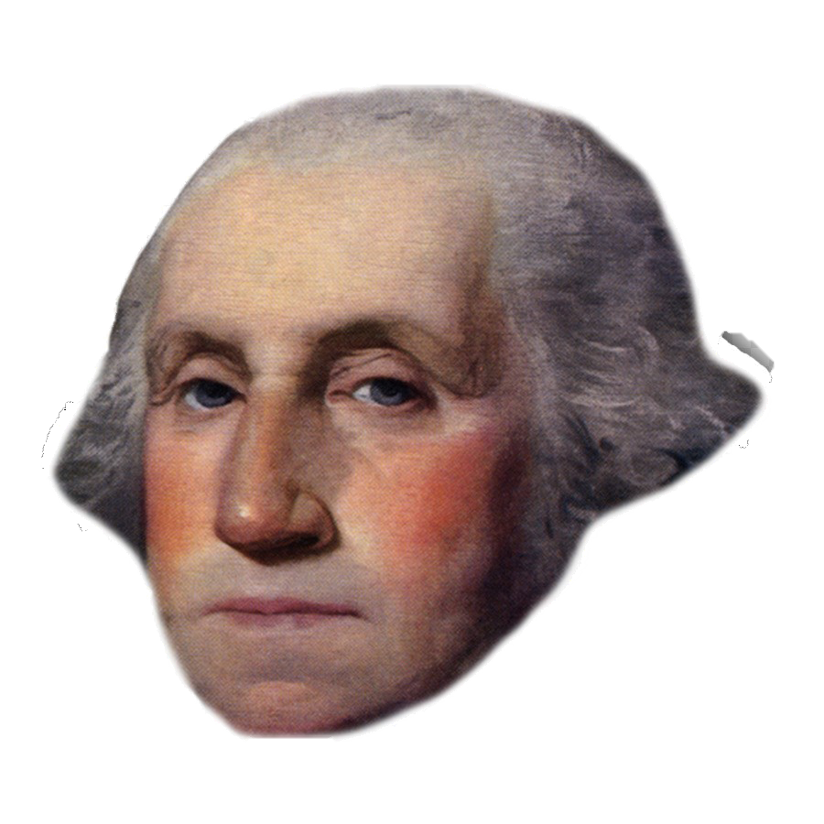
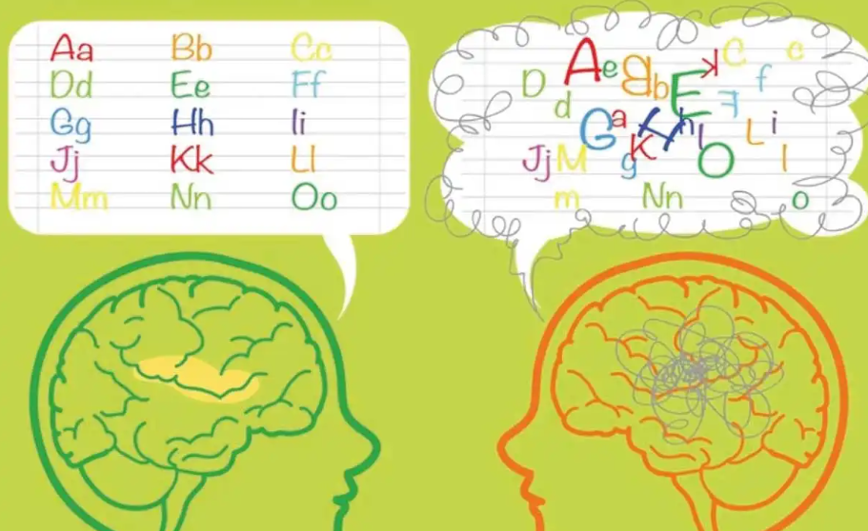

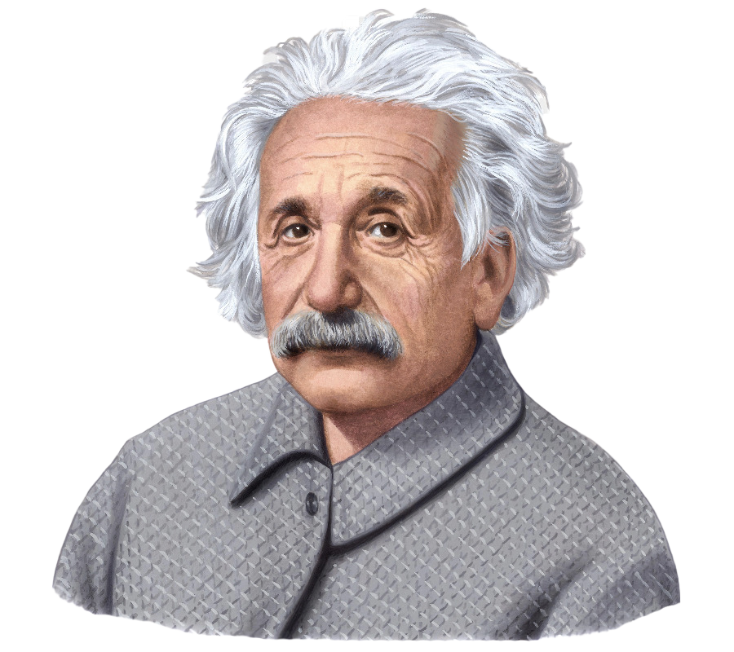
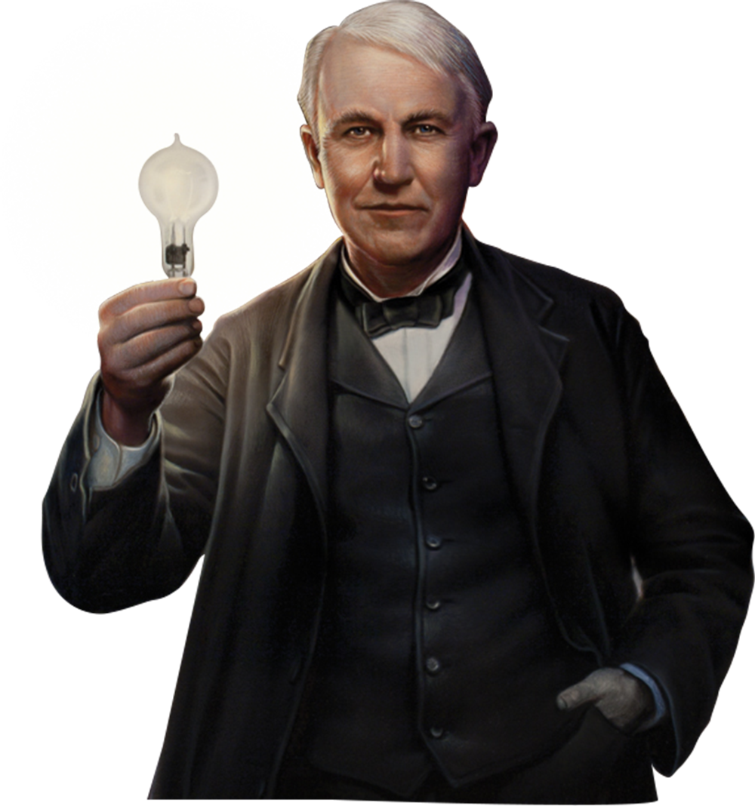
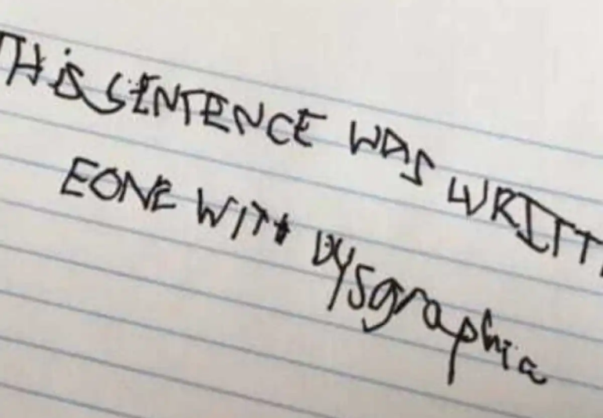
Dysgraphia
Dysgraphia is a challenge in expression, not a limit on intelligence.

Slide 5

Major signs and symptoms of Dyscalculia
Counting
1
They miss numbers while counting. They have difficulty operating addition sequences in mind. Dyscalculics, at this age, can’t relate arithmetic with real life concepts
Visual analysis
2
Trouble in recognizing, forming patterns and distinguishing by size, shape, or color.
Memory power
3
Trouble in remembering fundamental facts of maths such as addition, subtraction, multiplication and division.
Relating Concepts
4
Trouble in relating maths to real world concepts. They will find it difficult to keep up with the score card in sports, calculating price of items, pocket money, show timings.
5
Math anxiety
In some cases, Students may develop math anxiety. They may feel stress around numbers well into adulthood, negatively impacting their professional and personal lives.

